Slide 1


Strengthening Movement
Coordination & Cooperation
(SMCC)
ADMAG – Nairobi Sept 2018

Slide 2
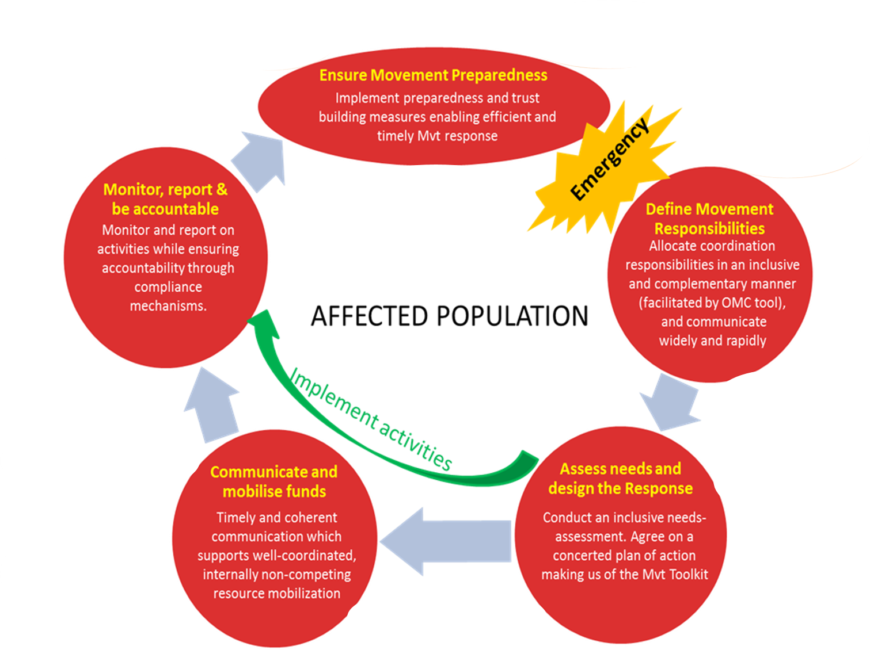
PoA 2015
MCA, MoU Contingency plans
Mini Summit joint statement teleconference
Joint RTE and lessons learned
Updated mapping of MVT capacities, interests, activities
Complementarity and harmonized NS CB
MvT coordination officers
Joint and/or coherent communications products
MvT Country plans
MvT coordinated appeal or one international appeal
MvT security framework
Complementarity and harmonized NS CB

Slide 4
Challenges
Need of “new” mind-set and modus operandi
Concomitant development of SMCC concepts/tools and implementation
Mis-perception: GVA-driven, Institution-driven, Global agenda vs operational reality
Transactional cost of coordination, Complexity?, flow of information

Slide 5
SMCC in Africa
South Sudan “country lab”
One international appeal (Nigeria, Ebola DRC)
Mapping?
Movement “country/response” plan?
Movement Contingency planning?
Promotion?
More dialogue

Slide 6
ADMAG SMCC objectives
B. Provide a platform to accelerate Movement coordination and cooperation and contribute to the implementation of the SMCC Plan of Action related to Disaster Management support to African National Societies

Slide 7
ADMAG SMCC objectives
Activities
1) Set up movement coordination
2) Disseminate the SMCC tools
3) Involve the ICRC into DREFs and EA
4) Integrate the SMCC early in the operation
5) Ensure to capture NSs’ views
6) Pilot MVT Contingency Planning in 3 countries
7) Pilot Joint Assessment Tools
8) Include SMCC within current trainings

Slide 8
In summary…
Shared understanding of the SMCC PoA
Use of existing/new tools for cooperation (e.g. MCA, Movement country plan, Movement contingency plan, etc.)
SMCC to be used for responding to “large-scale” emergency (and everywhere?)
Spirit of cooperation in all circumstances
Let’s try, explore together

Slide 9
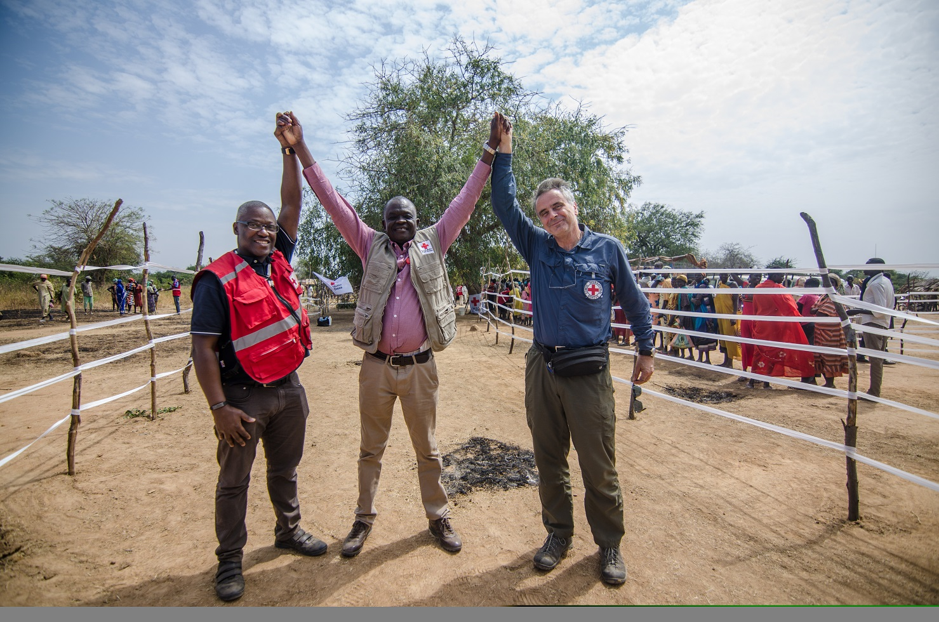
Thank you!

